Slide 1
Analysis of PCAP File Using Wireshark

Slide 2
Who Am I?
Praveen Pandyan
Threat & Forensics Analyst
Threat Hunting & DFIR

Slide 3
What you can expect from this talk?
High level analysis of a PCAP file
Extract IOCs from PCAP file
Download artefacts from PCAP file (exe, pdf, doc ..)
Notes:
WE will see high level analysis of a PCAP file
Then we will extract some IOCs from the PCAP and also download the artefacts from the pcap file

Slide 4
Network Forensics Process
Know your Triggering Events
Packet Capture Analysis

Slide 5
Know your Triggering Events
IDS alert
Noticeable anomaly (Virus activity)
Phishing Email
Known malicious/compromised system (I.e. Known C&C servers or to blacklisted countries)
Once you know the triggering event, filter out those packets.
Notes:
Before starting the analysis we

Slide 6
PCAP Analysis Methodology
Pattern Matching – Identify and filter packets of interest by matching specific values or protocol meta-data
List Conversations – List all conversation streams within the filtered packet capture
Export - Isolate and export specific conversation streams of interest
Draw Conclusions – Extract files or data from streams and compile data
Notes:
SO first we start with Pattern matching, where we need to identify packets of interest and filter out those packets. It could be IP or protocol.
Once we have the filtered packets we need follow the conversation streams, which will show the actual 2 way comm between src and dst.
Net will be to isolate the conversations of interest and also download the artifacts from them for further nalysis.

Slide 7
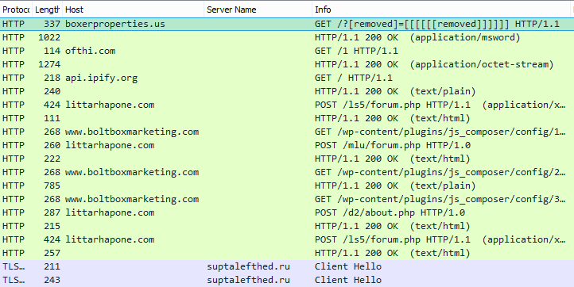
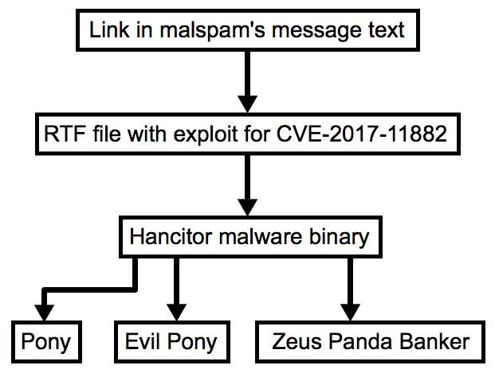
Scenario – Phishing Email Pushing Malware
Notes:
User gets a mail with a link
When clicked it downloads a RTF file. And when opened, it downloads a malicious binary and start the infection process.
On to the right te same can be seen in packet, which we will see in details now.
This is the first step, where we have filtered based on event of interest.

Slide 8
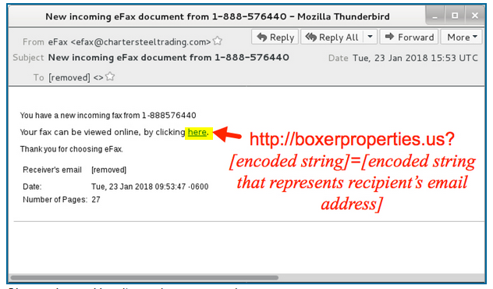
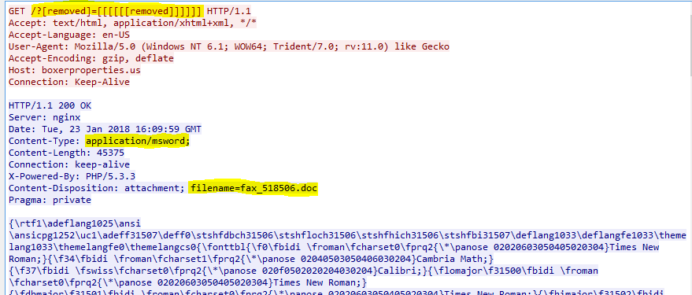
Phishing Link & Malicious Document Opened
Notes:
WE do a follow conversation to see the actual comm bet src and dst.
Once the user click the url, there is a get request and in response there is a RTF doc with file name efa.doc

Slide 9
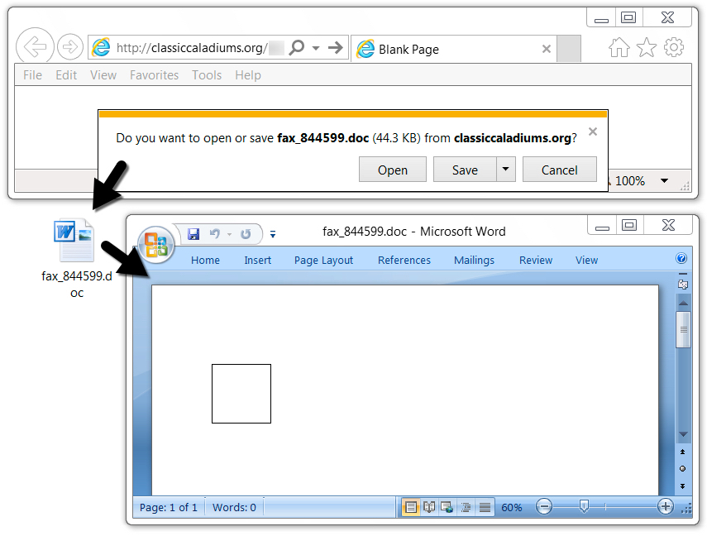
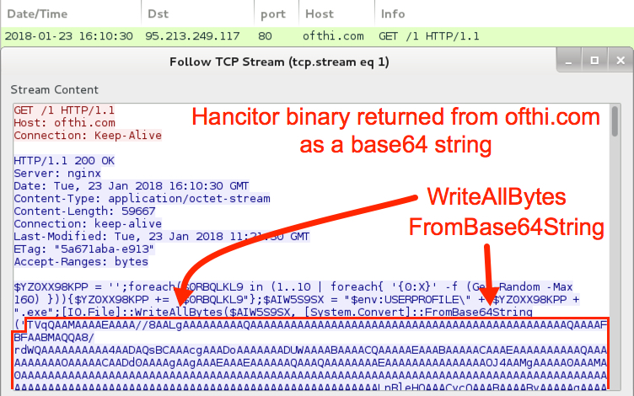
Notes:
opened the RTF file using Microsoft Word on a vulnerable Windows 7 host, and it automatically retrieved the malware binary and started the infection process. The binary was encoded as a base64 string in script returned from ofthi.com.

Slide 10

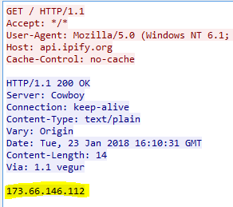
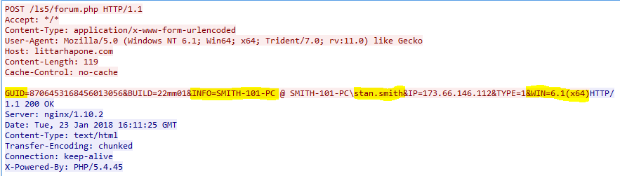
Post Compromise Traffic
Gets the IP address of the infected host and sends it to C&C (95.213.222.52)
HTTP streams for the C&C communication
Notes:
In previous step, the infection has started. It then sends some request to get the public IP of the victim and send it to C&C with other details.

Slide 11
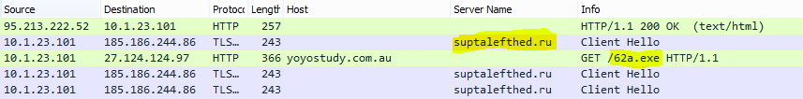
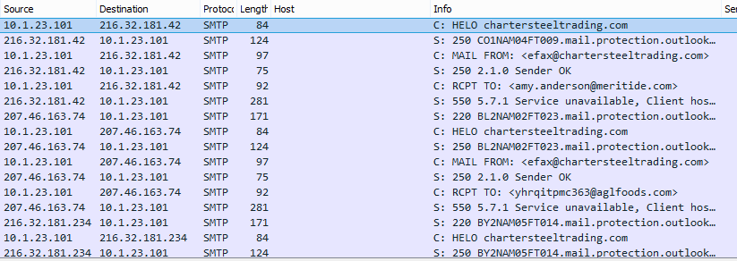
HTTPS/SSL/TLS traffic from Zeus Panda Banker Malware towards – suptalefthed(.)ru and downloads Send-Safe spambot malware.
Notes:
Access a site in Russia, which is associated with Zeus Malware and then it downloads a additional malware, which is spam bot.
After this file is downloaded the victim is used to send spam mail, we can see lot of SMTP comm.

Slide 12
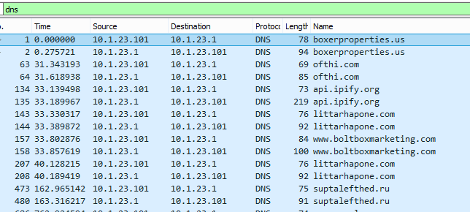
IOC Extractions
Search for all DNS request from this victims host to get the list of IOCs (IPs and domains)
Notes:
Ips and hostnames
Hash values of the files downloaded

Slide 13
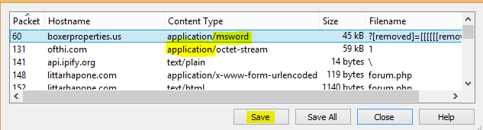
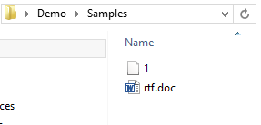
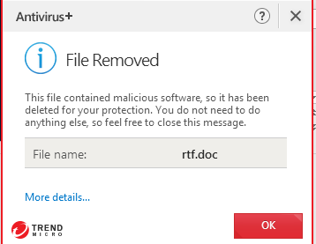
Downloading Artefacts from PCAP file

Slide 14
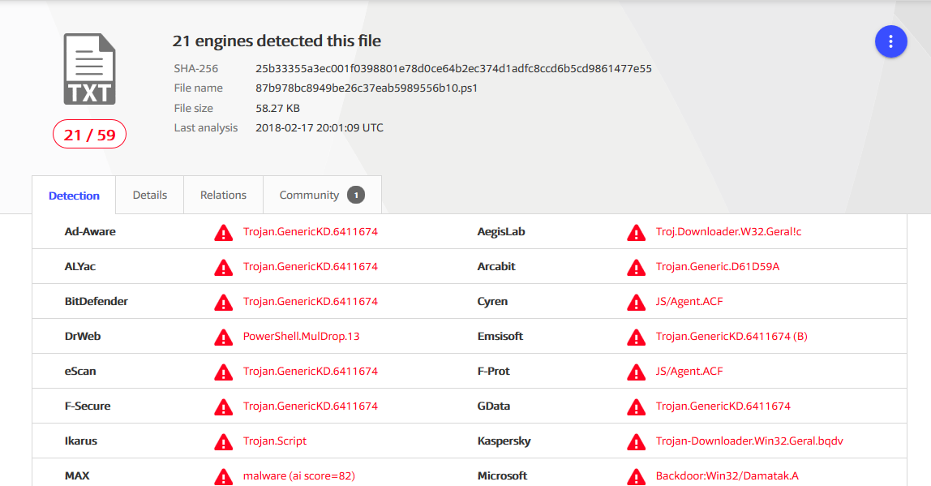
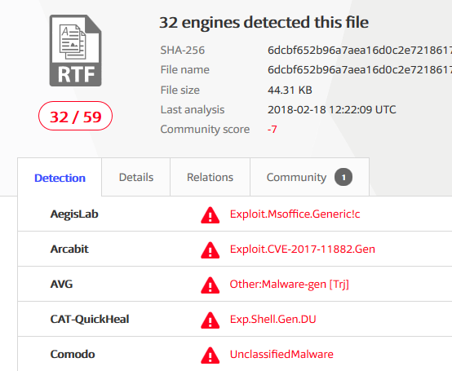
Analysis of Downloaded Files
Manual or Automated
1.ps1 rtf.doc
Notes:
Upload to online malware analysis tools
Or do a manual REM
In this I uploaded to virustotal, and this is the result.

Slide 15
Demo Time!

Slide 16

Thank You !!

